Slide 1
PE MO – Checker Process
Part 1: Prepare DCR Format
Prepared by Le Quang Vinh
December 27, 2025

Slide 2
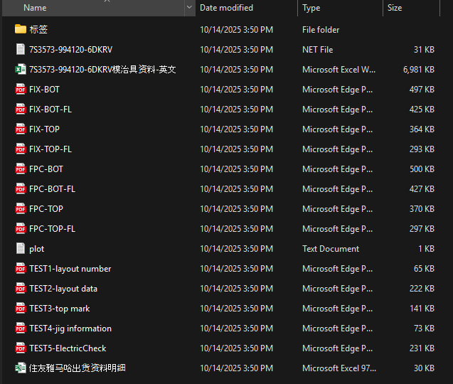
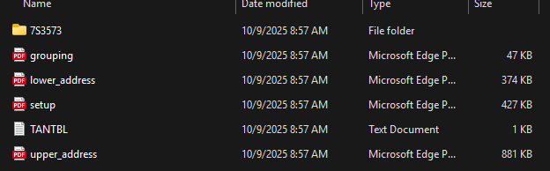
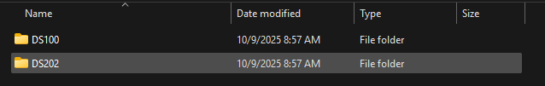
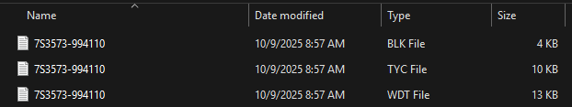
I. JIG Data from Maker
Example of Jig Data for Yamaha Machine
Example of Jig Data for Taiyo Machine

Slide 3
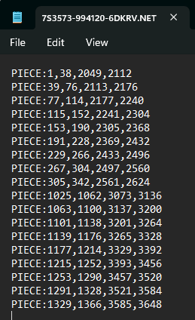
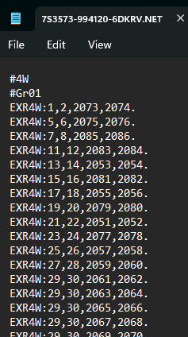
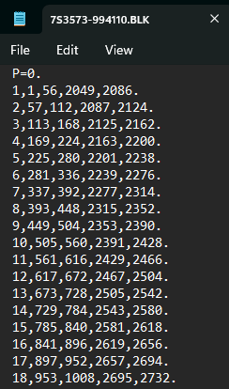
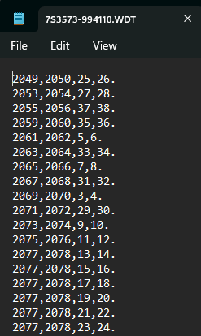
For Yamaha we only use Net File for Address Pin and 4W Pin
For Taiyo we only use DS100
In DS100 we use 2 file
BLK is for Address Pin
WDT is for 4W Pin

Slide 4
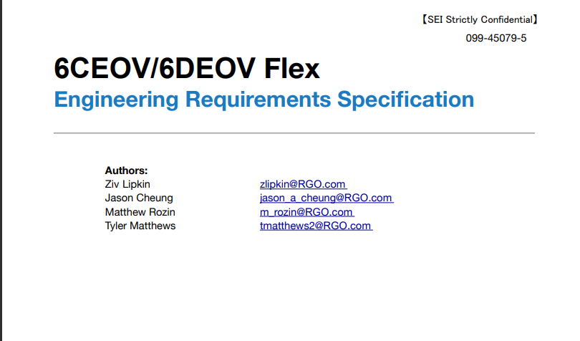
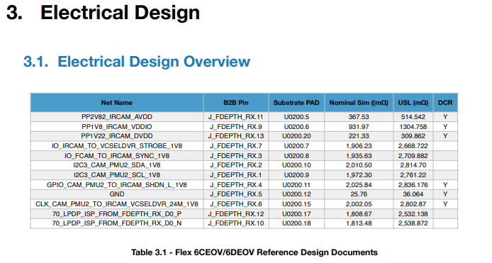
II. ERS (Engineering Requirement Specification
We will know the standard of customer for each item for serval NETS
Normally Customer will send us the PDF file
And we will search for Electrical Design that contain
Net Name
B2B Pin
Subtrade PAD
USL, LSL (For some item they only control USL)
*USL: Upper Standard Limit
*LSL: Lower Standard Limit

Slide 5

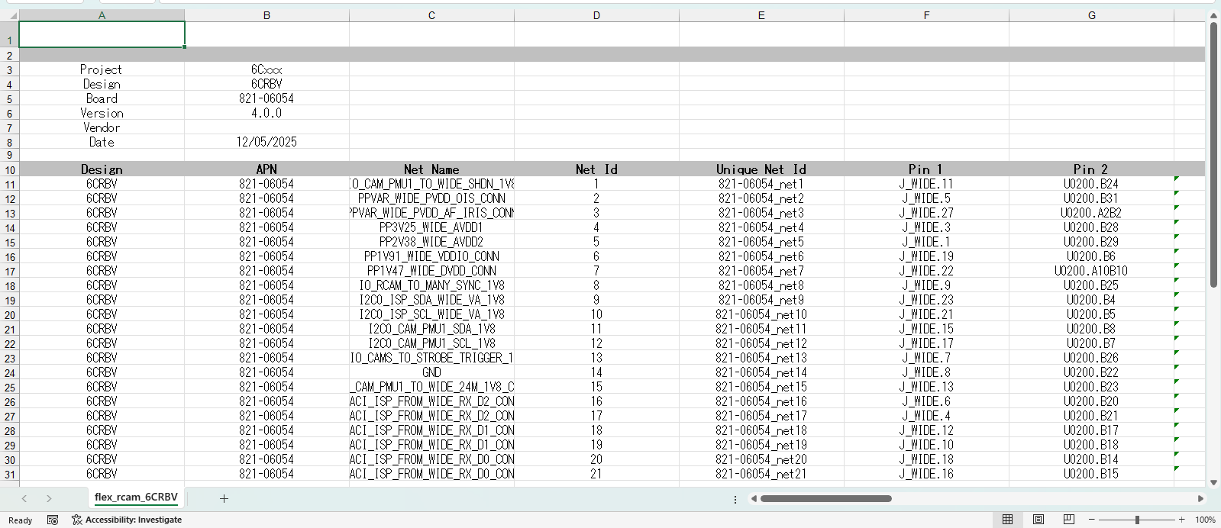
Usually DE will convert PDF file of Customer to Excel file

Slide 6
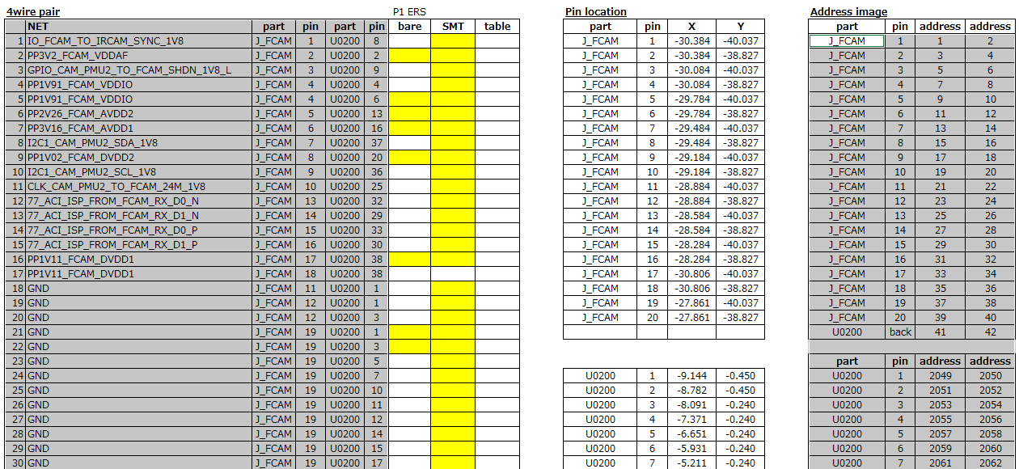
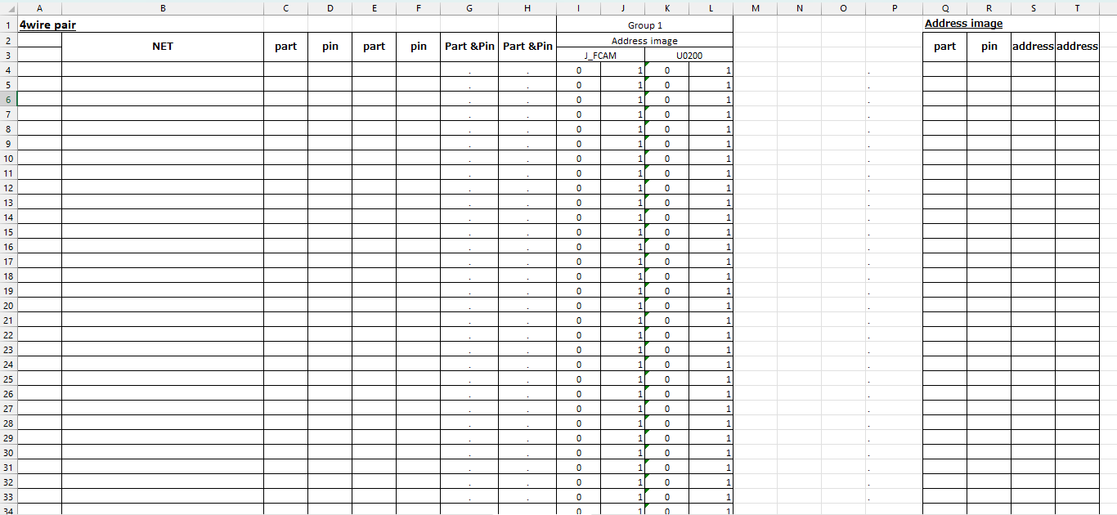
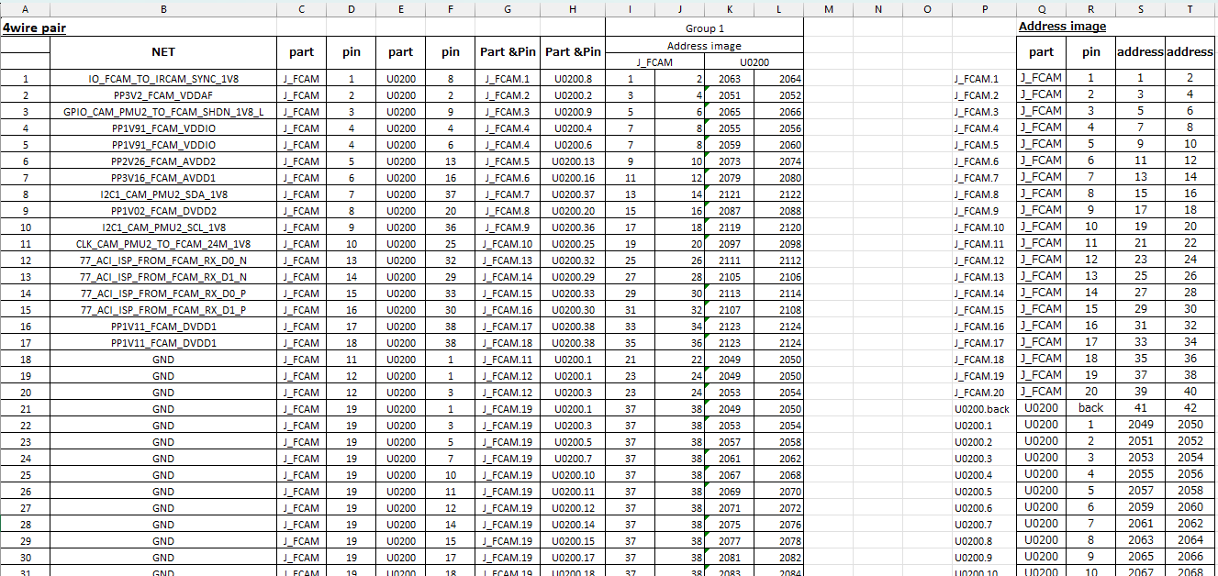
III. DCR Format
1. Copy all 4wire pair data and address Image from DE Requirement file to DE Requirement Sheet
Before
After

Slide 7
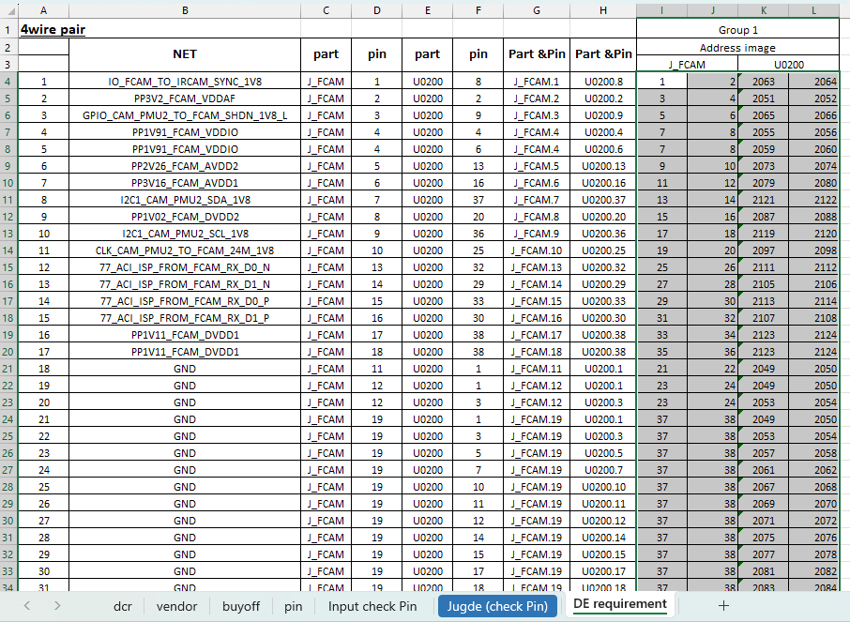
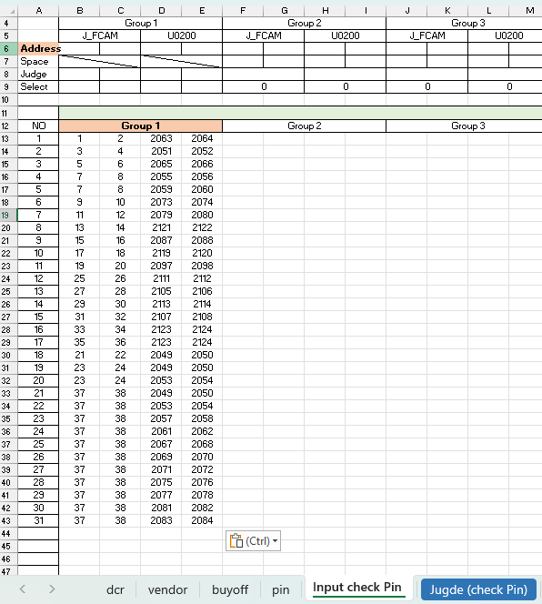
III. DCR Format
2. Copy all pin to Input check pin (This the sheet that we use to compare with Jig data of Maker)

Slide 8
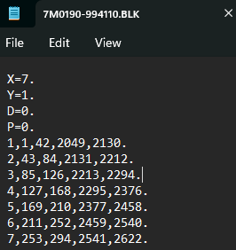
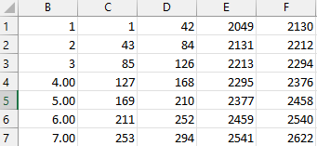
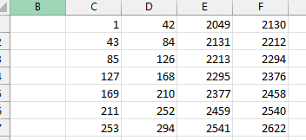
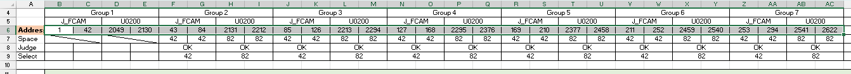
III. DCR Format
3.1 Open Jig Data from Maker
(This item runs on Taiyo Machine
-> open BLK and WDT File)
Copy address pin from BLK to “PIN” Sheet
The first column is number so we will delete it
Convert all data into 1 row.
Paste data in Address of “Input Check Pin” sheet and all the pin will automatically calculated

Slide 9
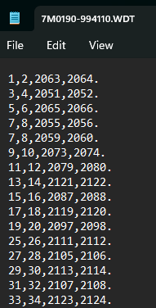
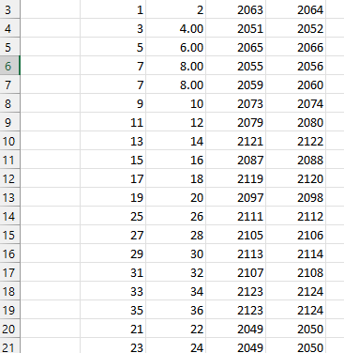
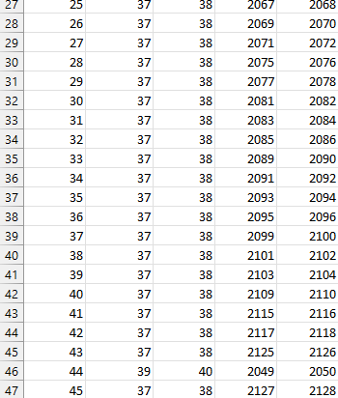
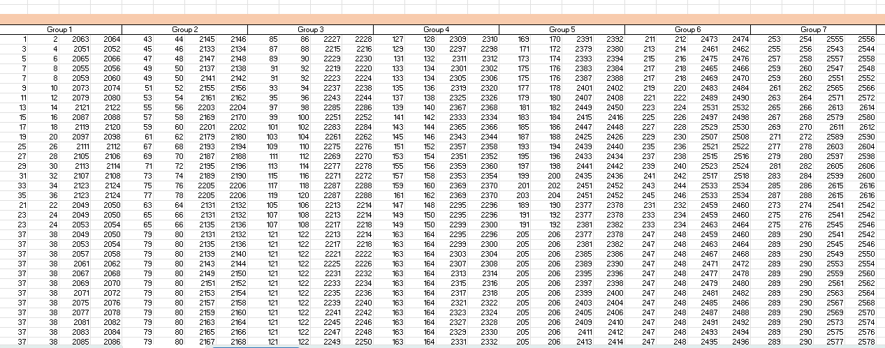
III. DCR Format
4.1 4W pin
Copy 4W pin from WDT to “PIN” Sheet
This item have 45 Net so when we paste into excel, we will numbered sequential from 1 to 45
Convert all data into 1 row (the same like address pin)
Paste in Orange Area (this is for 4W pin of Maker
Click “Judge(Check Pin)” Sheet to confirm OK or NG

Slide 10
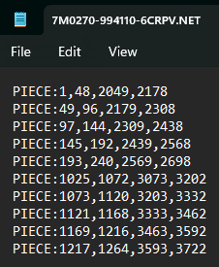
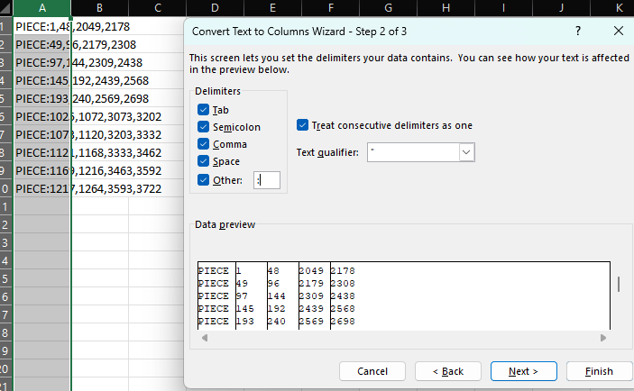
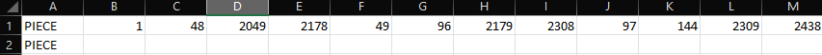
III. DCR Format
3.2 Open Jig Data from Maker
(This item runs on Yamaha Machine
-> open NET File)
Copy address address pin to “PIN” Sheet
Use text to column to separate number with comma
Convert all data into 1 row.
Paste data in Address of “Input Check Pin” sheet and all the pin will automatically calculated

Slide 11
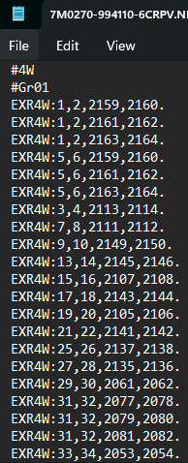
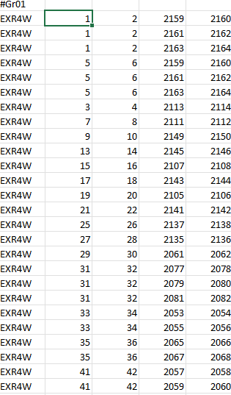
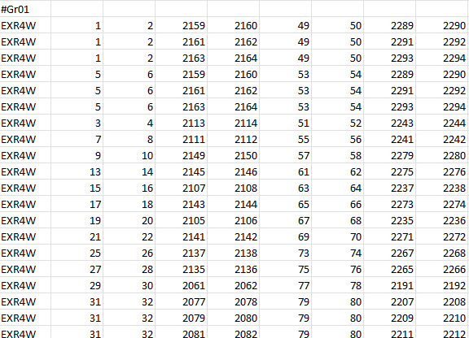
III. DCR Format
4.2 4W pin
Copy 4W pin from NET to “PIN” Sheet
Convert all group into 1 row (the same like address pin)
Paste in Orange Area (this is for 4W pin of Maker
Click “Judge(Check Pin)” Sheet to confirm OK or NG

Slide 12
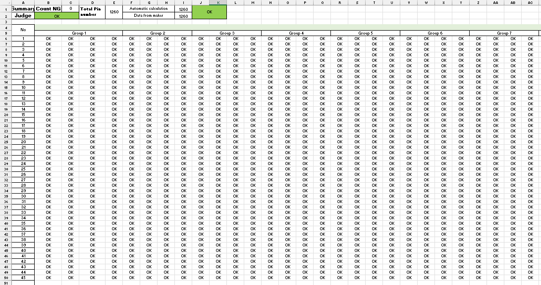
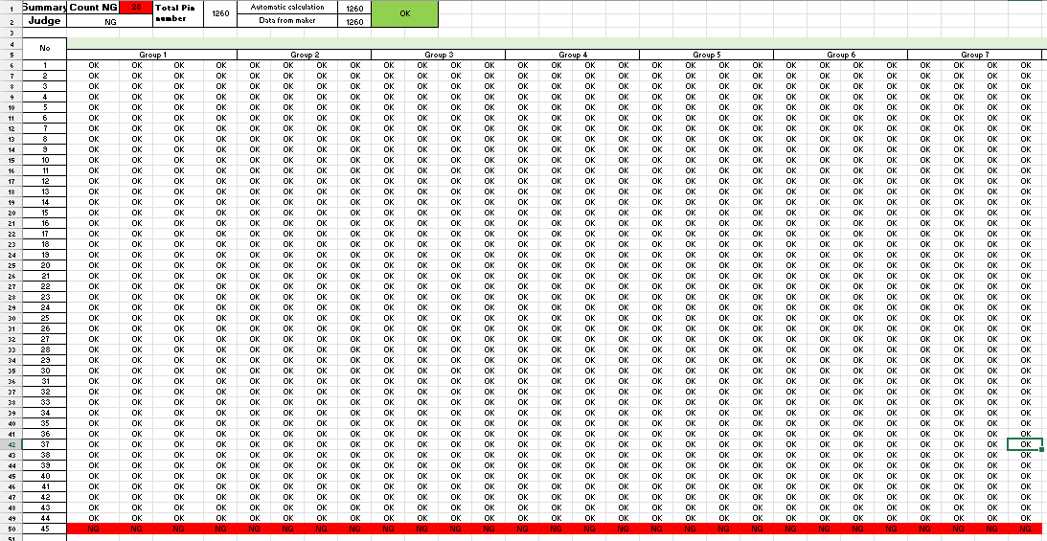
III. DCR Format
5. Check Pin between De Requirement and Maker
If Judge is OK we will move to next step
If Judge is NG we will double check to make sure we collect the right data of both De Requirement and Maker
If all the data we collect is correct we will feedback to Kim and Maker to confirm

Slide 13
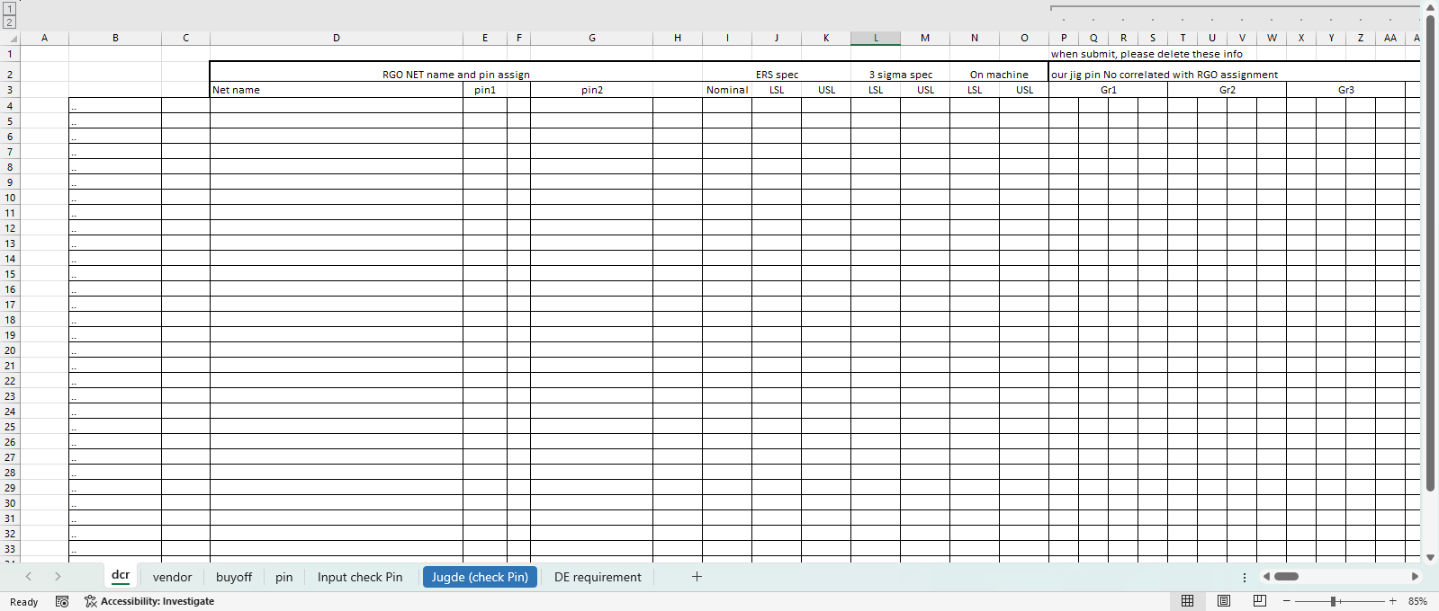
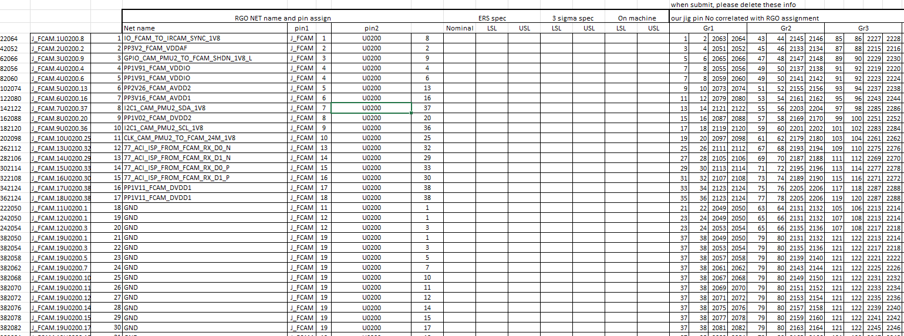
III. DCR Format
6. Copy all the data to “DCR” Sheet
Copy Net name and pin from DE Requirement sheet
Copy Group pin from “Input Check Pin” Sheet

Slide 14
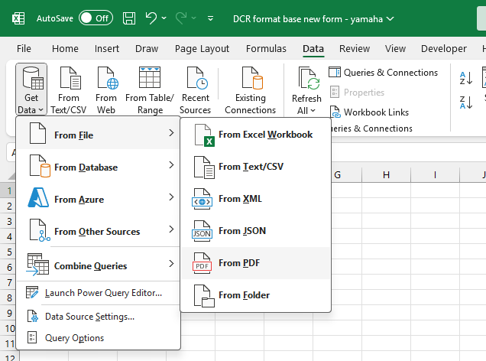
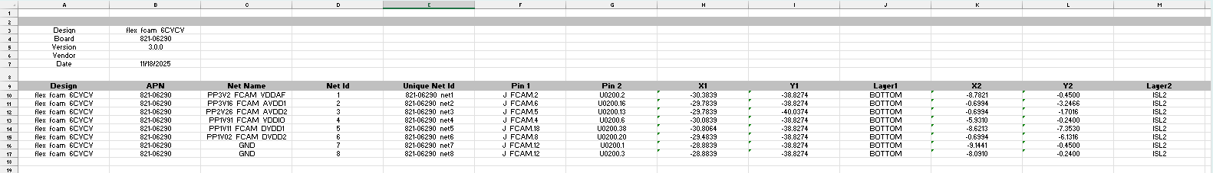
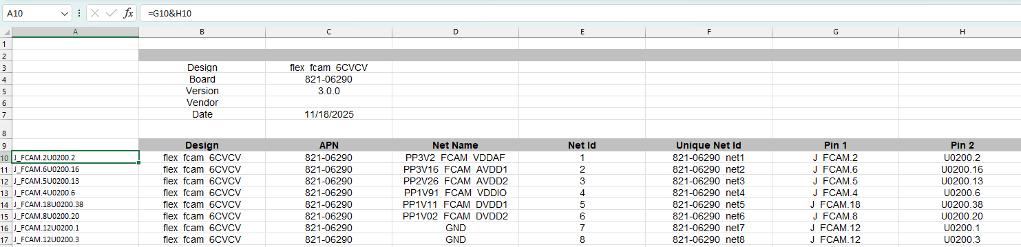
III. DCR Format
7. Copy/Insert Vendor Spec
If we only have PDF file, we will get Data from PDF file
If we have excel file from DE team, copy all the data to “Vender Spec” Sheet
Insert 1 column and combine Pin 1 & Pin 2

Slide 15
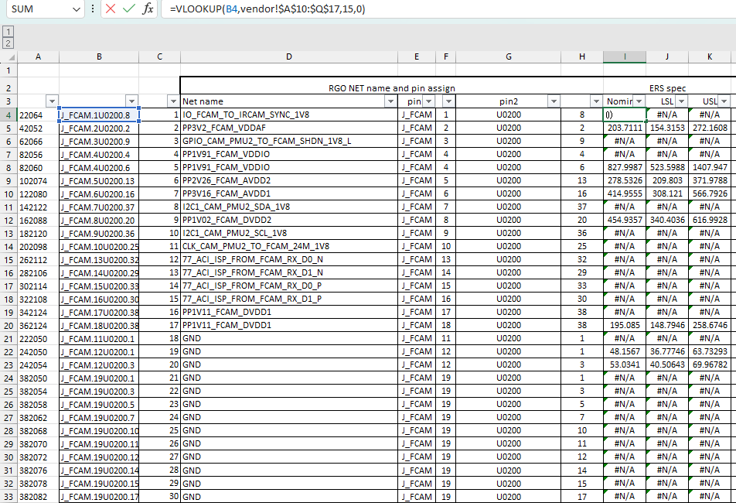
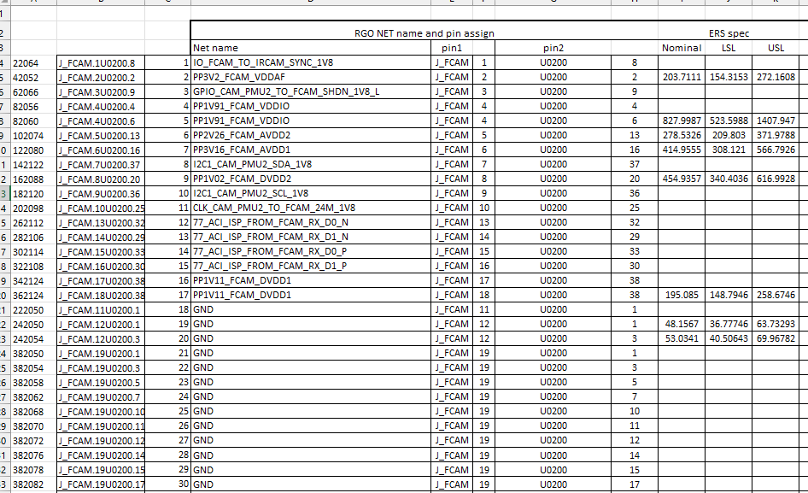
III. DCR Format
8. Insert ERS to DCR Sheet
Use Vlookup formula to insert ERS
Delete all #N/A using filter

Slide 16
PE MO – Checker Process
Part 2: Calculate 3 Sigma
Prepared by Le Quang Vinh
December 27, 2025

Slide 17
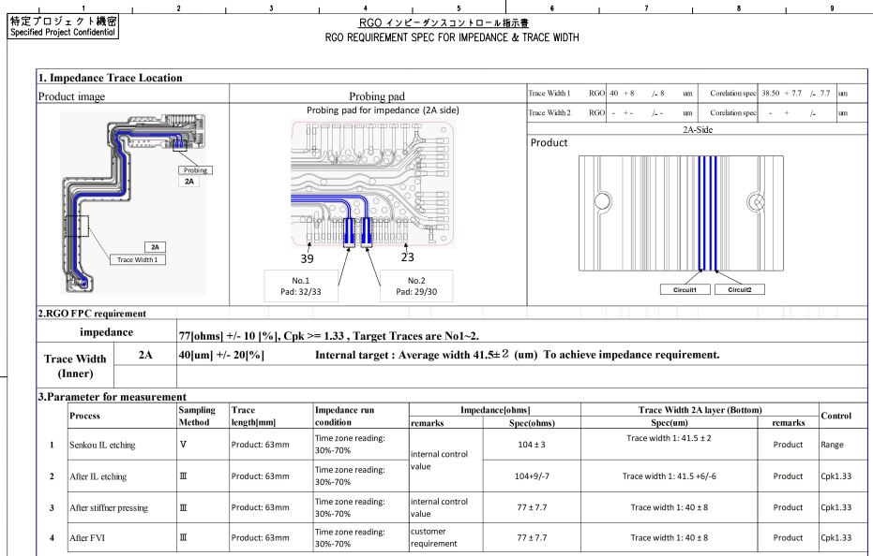
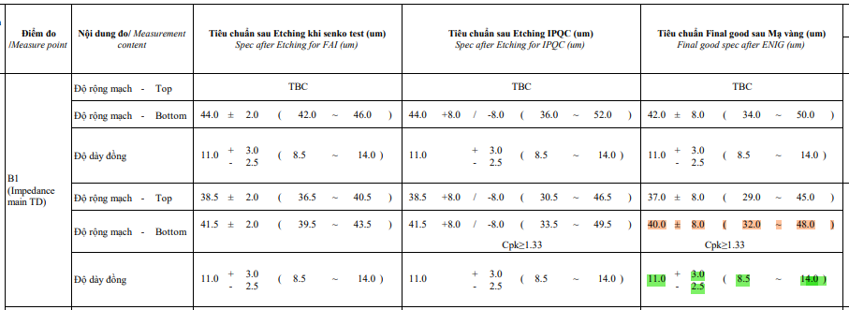
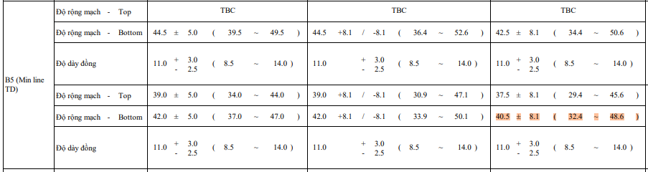
I. Specification for Impedance, Min Line, Other Net
1. Getting Etching & S-Draw Specification
In S-Draw we will know Which Net is Impedance and Impedance Spec
In S-Draw we will know Impedance circuit width, Min Line circuit Width Spec, Copper thickness (We only use bottom spec of final good spec after ENIG (um) )

Slide 18
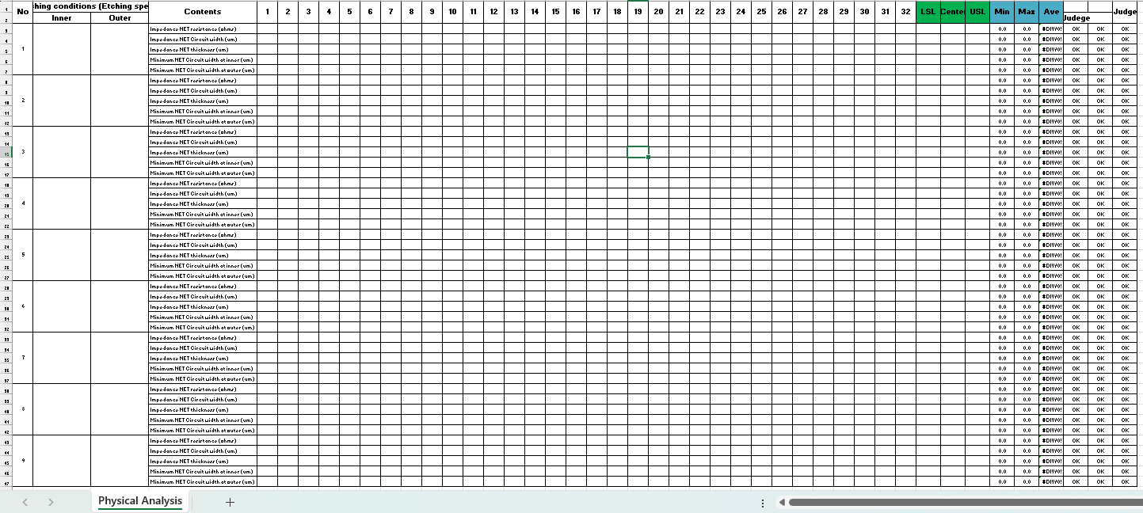
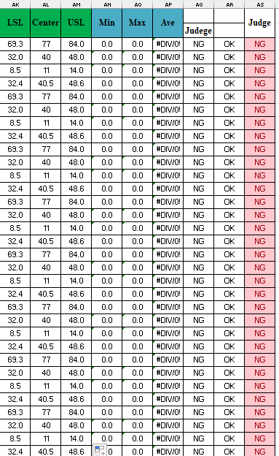
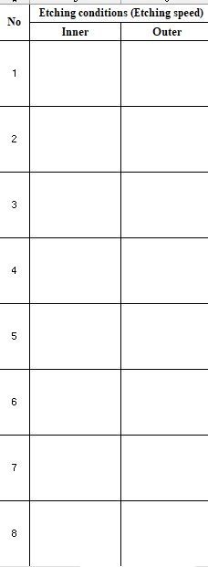
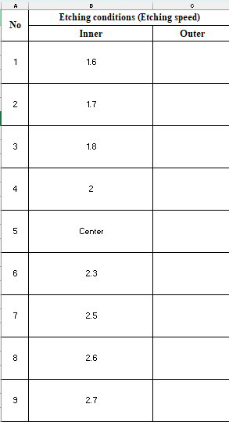
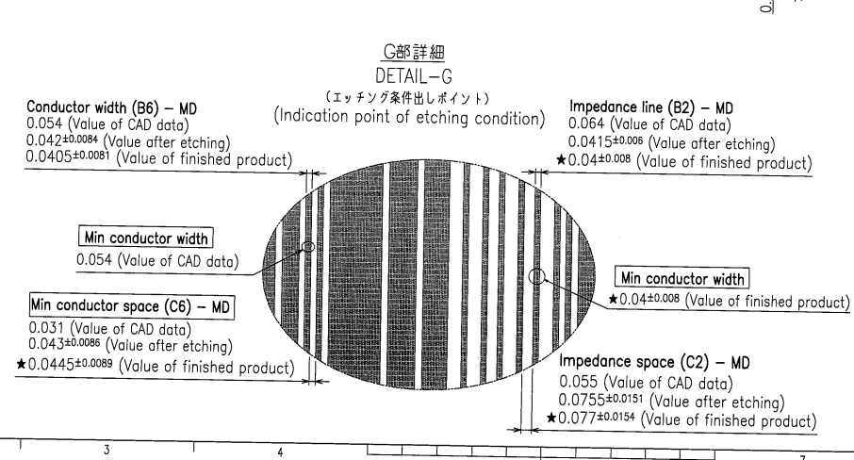
I. Specification for Impedance, Min Line, Other Net
2. Add Spec to “Form Measurement result file”
3. Add 9 Condition name
Note: We have to confirm Min line at inner or outer by checking S-Draw

Slide 19
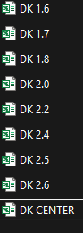
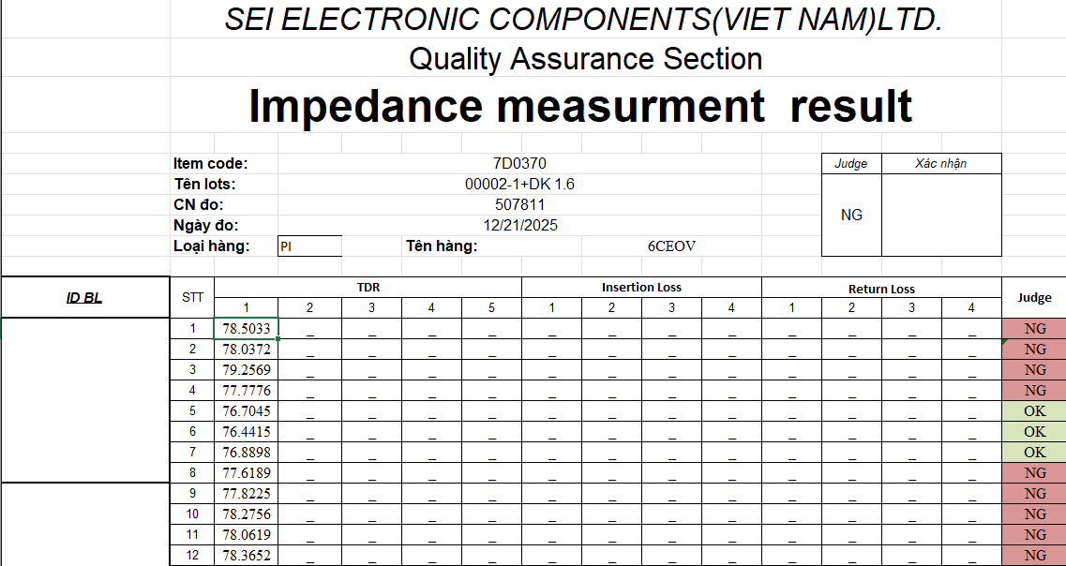
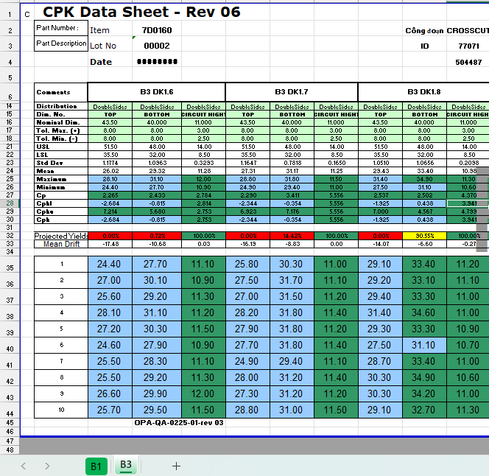
I. Specification for Impedance, Min Line, Other Net
4. Add Result for each conditions
For Impedance we will have 9 file
Inside each file will have 32 results of Impedance resistance
For Impedance we will have a combine file
Impedance (B1) we will take Circuit Width (Bottom) and Circuit height
Min line (B3) we will take Circuit Width (Bottom)

Slide 20

I. Specification for Impedance, Min Line, Other Net
5. Choose Conditions to calculate 3 sigma
We will collect logfile base on conditions that judged OK

Slide 21


II. Collect logfile for Impedance, Min Line, Other Net
For Yamaha we will collect .CSV file
For Taiyo we will collect .TEXT file

Slide 22


II. Collect logfile for Impedance, Min Line, Other Net
To Summarize logfile for Yamaha and Taiyo machine type we have 2 difference App for both machine type
For Taiyo Machine
For Yamaha Machine

Slide 23

II. Collect logfile for Impedance, Min Line, Other Net
1. Taiyo Machine
Step 1: choose file that contain selected condition
Step 2: Click create CSV file
Step 1
Step 2

Slide 24




II. Collect logfile for Impedance, Min Line, Other Net
1. Taiyo Machine
Step 3: Filter PointNo from Smallest to Largest
Step 4: Do it for all files
Step 5: Copy resistance value to 1_tmp

Slide 25




II. Collect logfile for Impedance, Min Line, Other Net
1. Taiyo Machine
Step 6: Open Calculate UCL,LCL file and input Net number/Pieces count/Column count in “Sap xep” Sheet
Step 7: Copy PonitNo, Point+V, Point-V to Net No, PinA, PinB & Resistance Value
Step 8: Run the marco to convert data

Slide 26


II. Collect logfile for Impedance, Min Line, Other Net
1. Taiyo Machine
Step 9:Copy all converted data to “tinh UCL,LCL” Sheet
Step 10: Copy UCL, LCL data to “Calculate UCL,LCL

Slide 27

II. Collect logfile for Impedance, Min Line, Other Net
1. Taiyo Machine
For Taiyo Machine’s deviation so we ±10 mohm
If UCL higher than USL or LCL lower than LSL we will fix it to make sure UCL, LCL under USL, LSL
The same apply for Impedance, Minline, Other Net

Slide 28

II. Collect logfile for Impedance, Min Line, Other Net
2. Yamaha Machine
Step 1: choose file that contain selected condition
Step 2: Click Process Data
Step 1
Step 2

Slide 29



II. Collect logfile for Impedance, Min Line, Other Net
2. Yamaha Machine
After Process we will have 1 file “Merge” and other Processed file
Step 3: Choose merged_file
Filter column Method -> choose 3 (3 mean 4Wire, 2 mean 2Wire)
Step 4: Insert a new column on the left side of Pin A column
Numbered sequentially Net no (Ex: 1 to 69)
Check at the end of column: If the end is 69 that is correct, if not check the Net number again

Slide 30



II. Collect logfile for Impedance, Min Line, Other Net
2. Yamaha Machine
Step 5: Copy and Transpose all data to “tinh UCL,LCL” Sheet
From Step 6 do exactly the same like Taiyo Machine

Slide 31

Finally paste all the UCL, LCL from Calculate file back to DCR file

